Slide 1
Arithmetic Pipeline

Slide 2
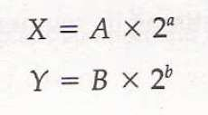
Floating point operations.
The inputs to floating point adder pipeline are two normalized floating point numbers.
Mantissa
Exponent
A and B are mantissas and a and b are the exponents.
The floating point addition and subtraction can be performed in four segments.

Slide 3
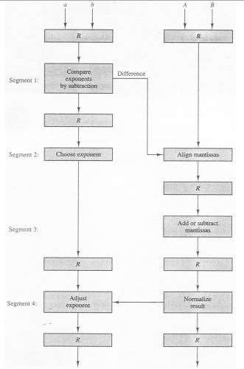
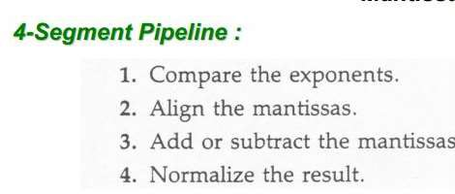
Floating-Point Add/Subtraction Pipeline:
Mantissa
Exponent

Slide 4
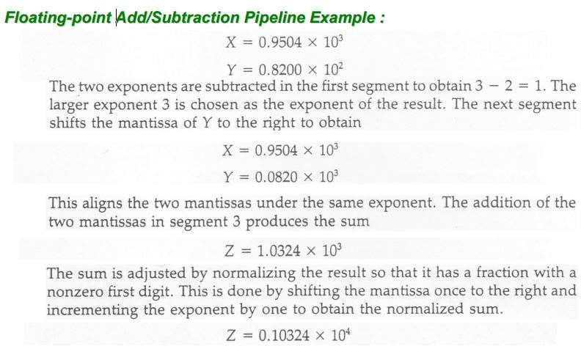

Slide 5
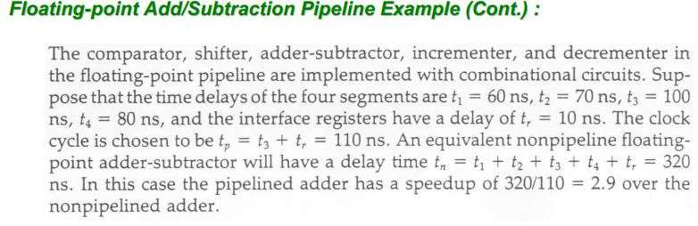

Slide 6
Watch this video
https://youtu.be/j61s-sB9uUk

